Slide 1

Hotel Aggregator Analytics Insights
Joel Charles

Slide 2
Agenda
1
2
3
4
5
Geographical
Insights
Pricing and Availability
Host Performance
Property and Room Type Analysis
Guest Satisfaction

Slide 3

Introduction
This project aims to analyze a dataset of hotel aggregator listings using Power BI. The dataset comprises various attributes related to listings, hosts, reviews, and availability. The objective is to create comprehensive visualizations and insights that shed light on trends, patterns, and factors influencing the performance of listings. Through Power BI, interns will explore key metrics such as pricing, availability, host characteristics, and review scores to derive actionable insights for improving the overall quality and competitiveness of the listings.

Slide 4

Geographical Insights

Slide 5
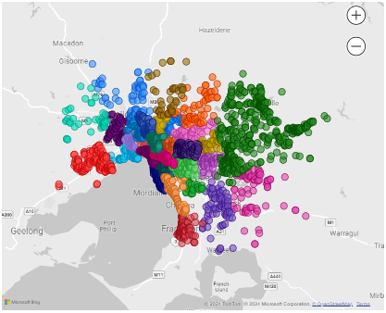
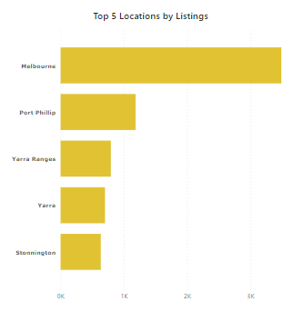
Geographical Insights

Slide 6

Pricing and Availability

Slide 7
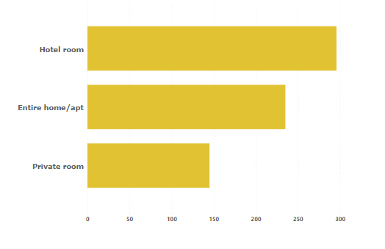
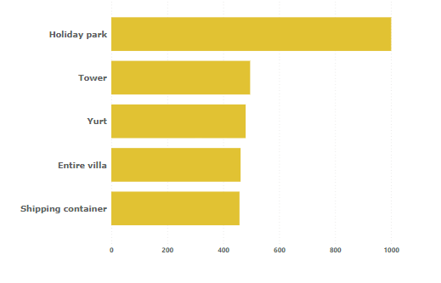
Pricing
Average Prices by Room Type
Top Average Prices by Property Type

Slide 8
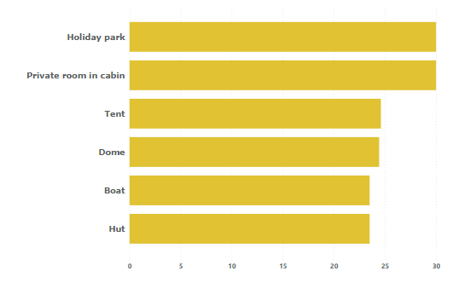
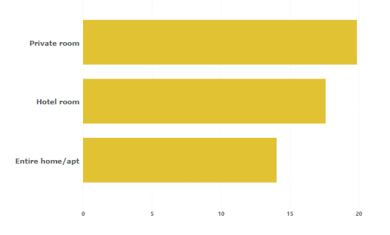
Availability
Average Monthly Availability by Property Type
Average Monthly Availability by Room Type

Slide 9
Host Performance

Slide 10
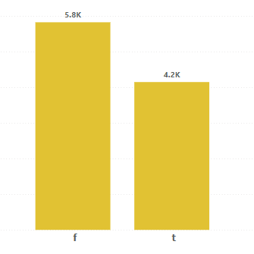
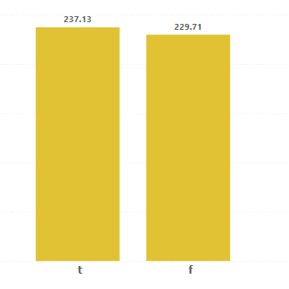
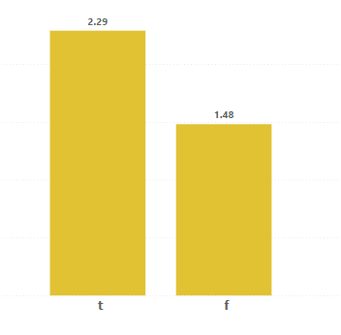
Superhost
Distribution of Superhost(t/f)
Average Price by Superhost
Average Monthly Reviews

Slide 11
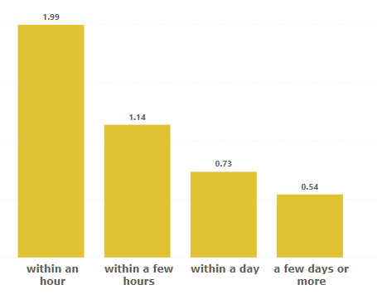
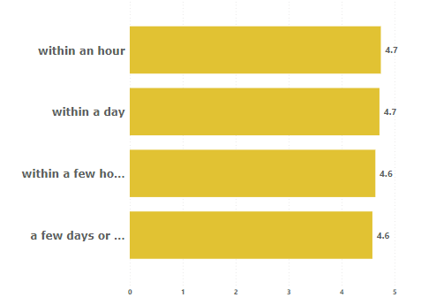
Host Response
Average Monthly Reviews by Host Response
Average Rating by Host Response

Slide 12
Review Score and Guess Satisfaction

Slide 13
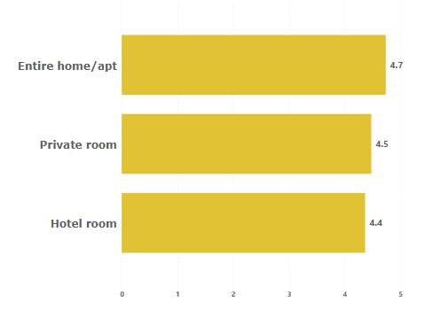
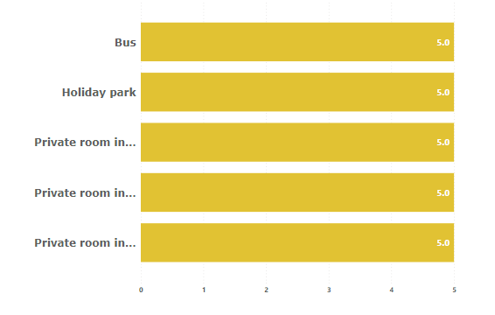
Review Scores/Guest Satisfaction

Slide 14
Property Type and Room Analysis

Slide 15
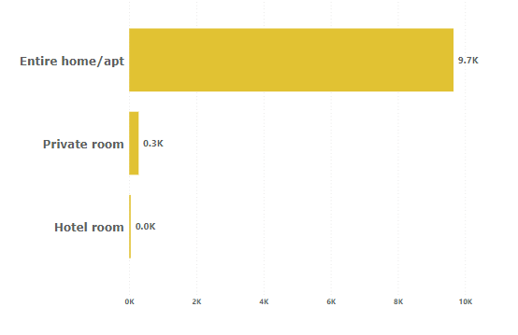
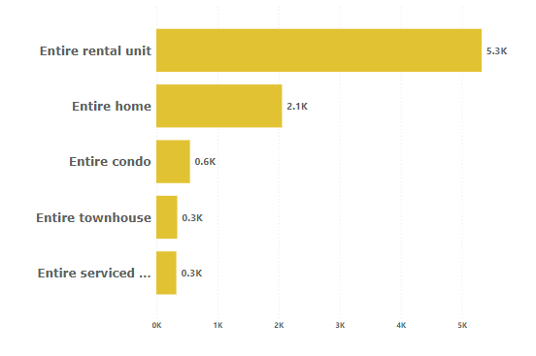
Listings
Distribution of Listings by Room Type
Distribution of Listings by Property Type

Slide 16
Areas of focus
Host
Improve response time to customer request, customers prefer quicker attention.
Aim towards attaining the ‘Superhost’ status, it attracts customers more.
Focus on the property types that are popular, there is more market for them.
Aggregator
Platform
Promote Cheaper Property types that are popular.

Slide 17

Thank you
Joel Charles
joelcharles906@gmail.com

